Slide 1

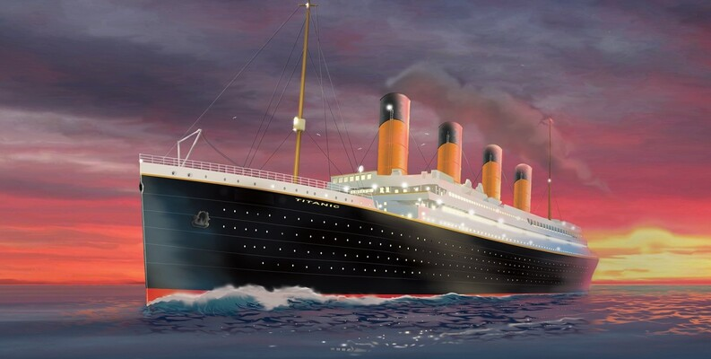
Unlocking the Story Behind the Numbers
Dive Into Titanic’s Passenger Stories
By
K Nithin Kumar
U Lakshmi Savya
G Satyanjani

Slide 2
Project Overview
This dataset contains real passenger information from the Titanic’s tragic voyage in 1912. It includes details like age, gender, ticket class, fare, and whether each passenger survived. The data is commonly used for learning data analysis and building beginner machine-learning models. It helps us explore patterns such as who had higher chances of survival and why.This project uses the Titanic passenger dataset to understand the structure, quality, and characteristics of the data before performing any analysis or modeling. The dataset contains demographic and travel-related information of passengers aboard the Titanic and includes a survival indicator. The goal of this phase is to explore the dataset, identify data types, detect missing values, and assess overall data quality.

Slide 3
Simple description of each column in Titanic dataset:
1.survived - passengers who survived
2. pclass - passenger class
3. sex - gender of passenger
4. age - age of the passenger
5. sibsp - number of siblings / spouses aboard the titanic
6. parch - Number of Parents / Children aboard the Titanic
7. fare - Amount of money paid by the passenger for the ticket
8. embarked - Port where the passenger boarded the Titanic
9. class - Passenger travel class
10. who - Type of passenger based on age & gender
11. adult_male - Passenger is an adult male not an adult male (woman or child)
12. deck - Deck level of the cabin
13. embark_town - embarkation port
14. alive - survival status
15. alone - Passenger traveled alone or with family

Slide 4
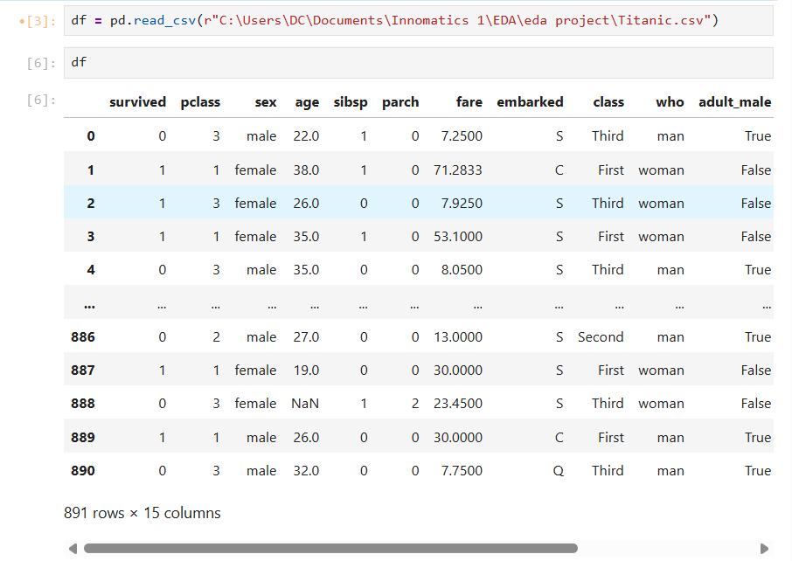
PHASE-1 : DATA UNDERSTANDING
Reading Dataset

Slide 5
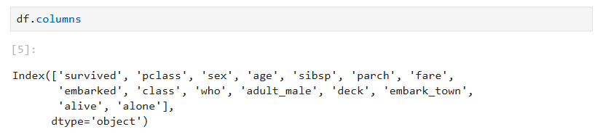
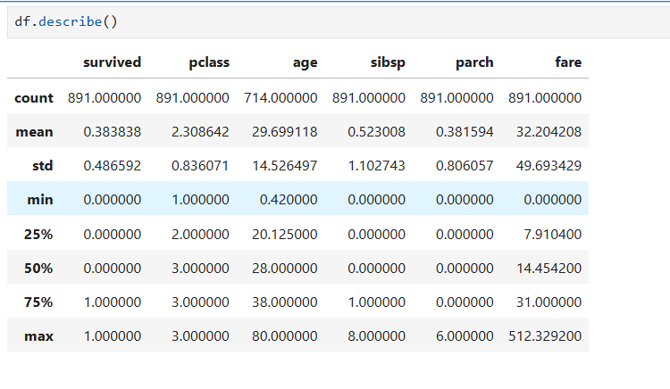
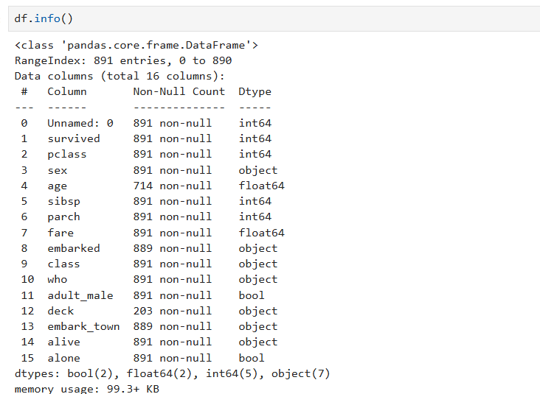
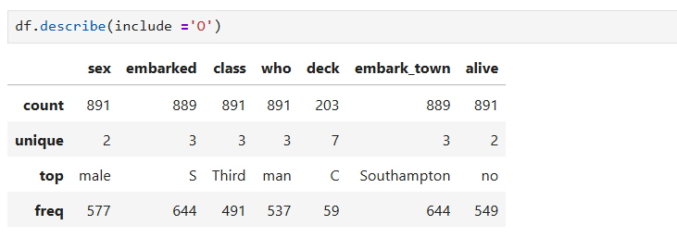
Basic Checks
Checking summary statistics of numerical columns
Columns of dataset:
Checking structure of the dataset
Checking summary statistics of categorical column

Slide 6
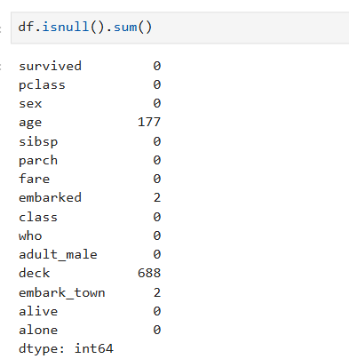

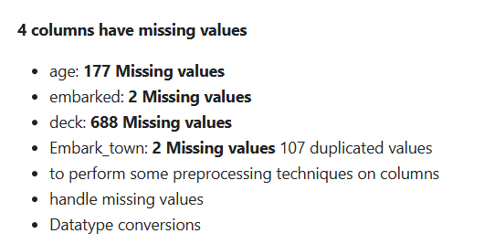
Preprocessing Techniques on Dataset Individual Columns
Checking missing values:
Check for duplicate values:

Slide 7
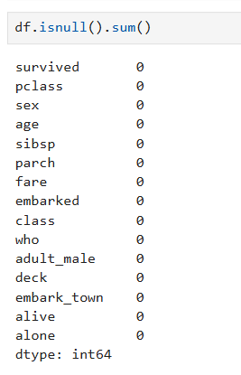

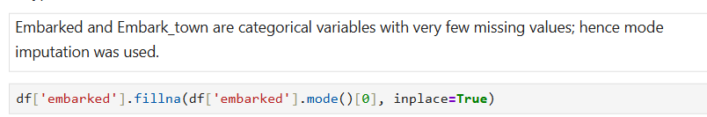
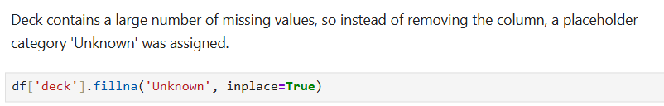
PHASE-2
DATA CLEANING AND MANIPULATION
1.Handle Missing Data¶
Column: age
Column: embarked
Column: embark_town
Column: deck

Slide 8
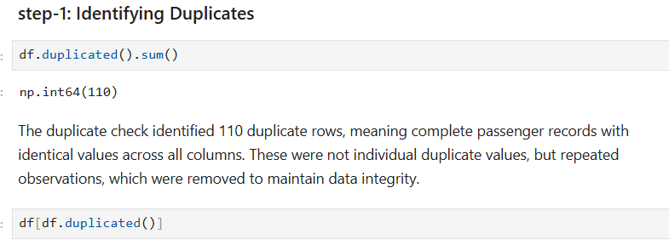
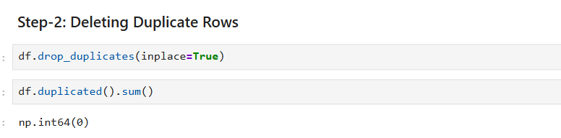

2.Remove Duplicates

Slide 9
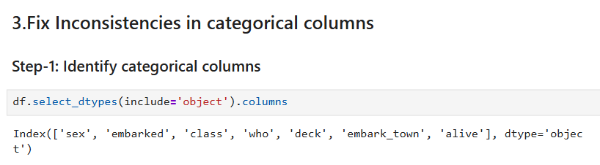
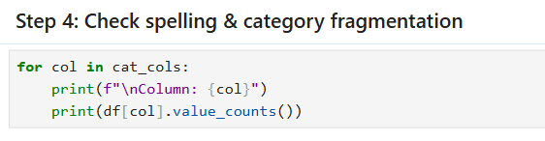
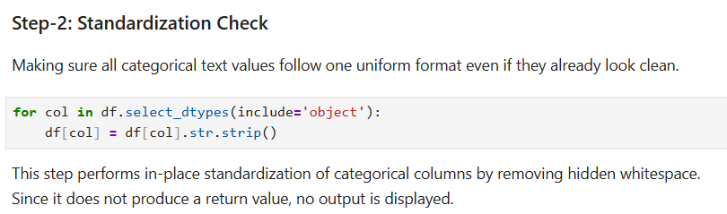
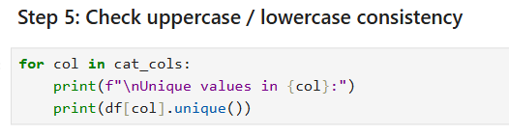
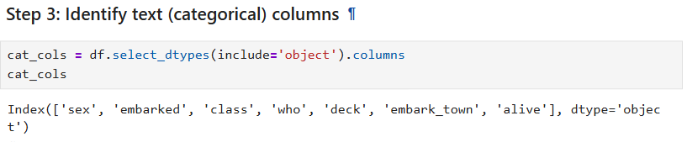
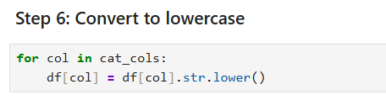

Slide 10
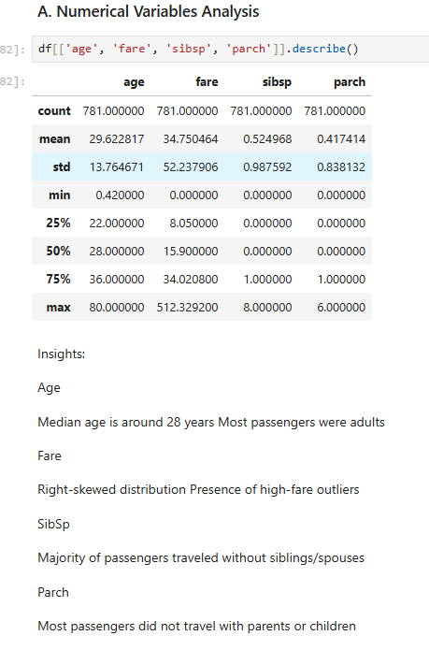
4.Non-Visual Univariate Analysis

Slide 11
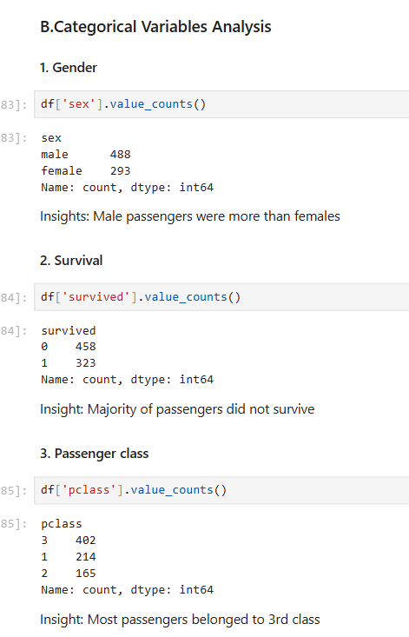
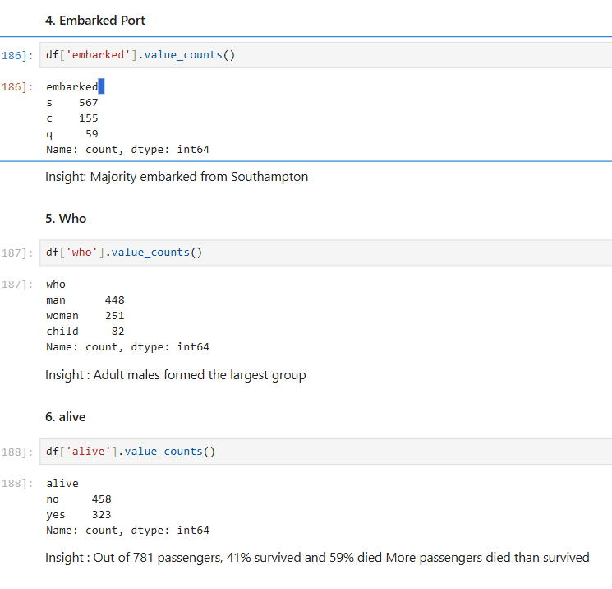

Slide 12
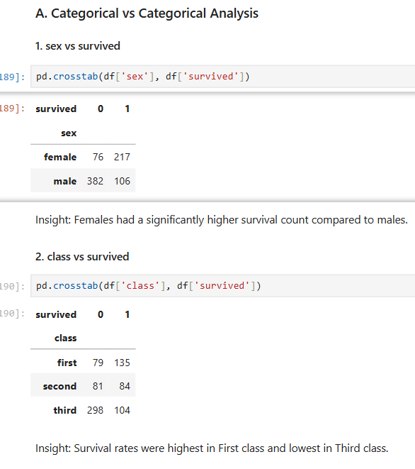
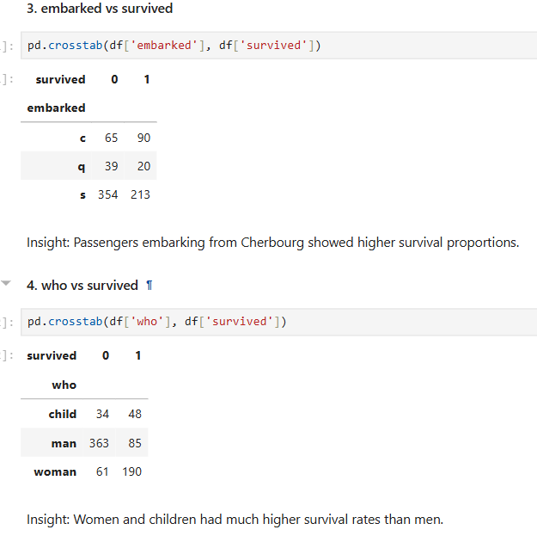
5.Non-Visual Bivariate Analysis

Slide 13
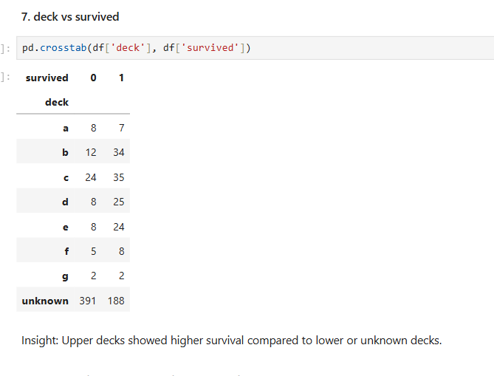
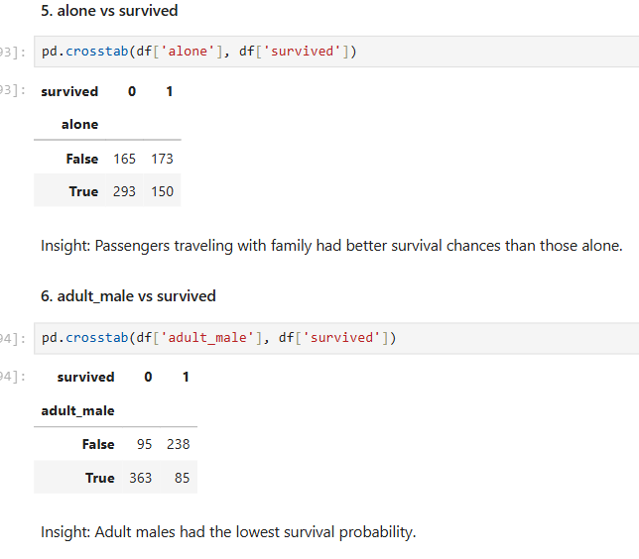

Slide 14
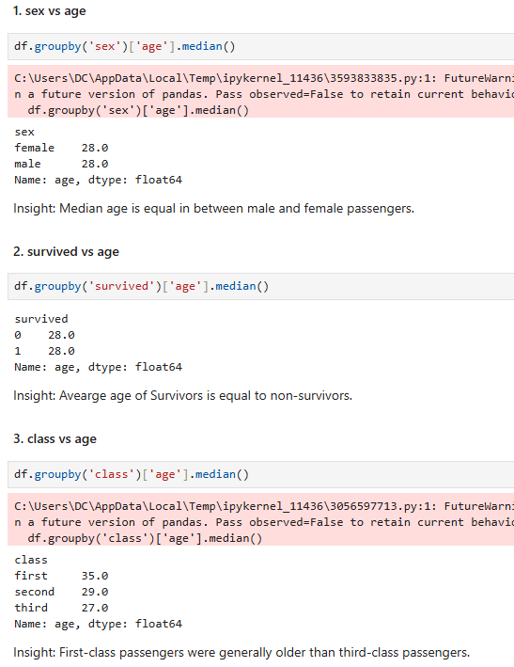
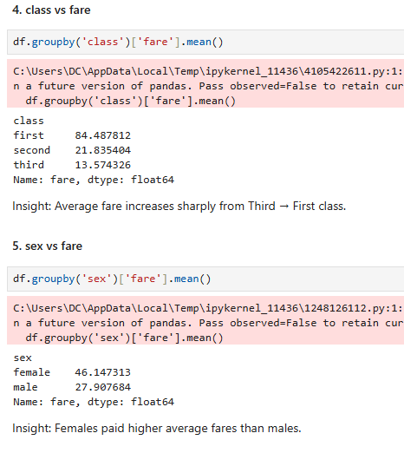
Categorical vs Numerical Analysis

Slide 15
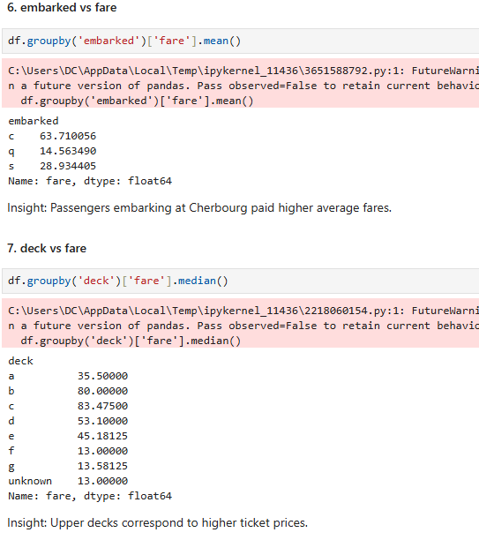
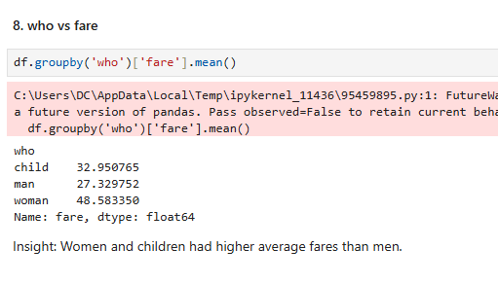

Slide 16
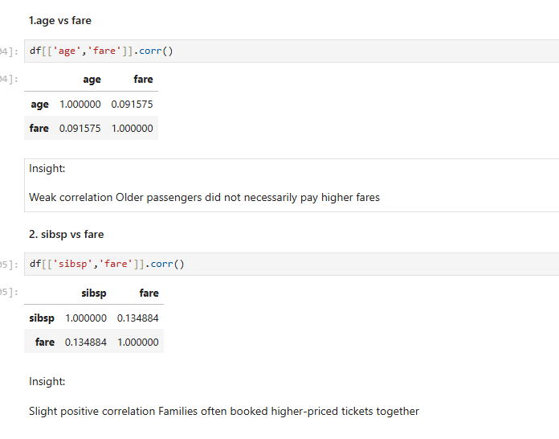
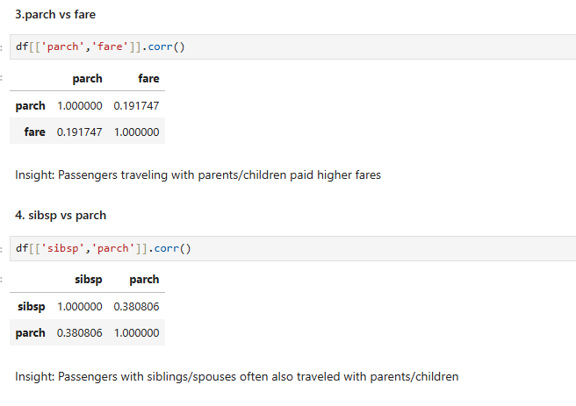
Numerical vs Numerical Analysis

Slide 17
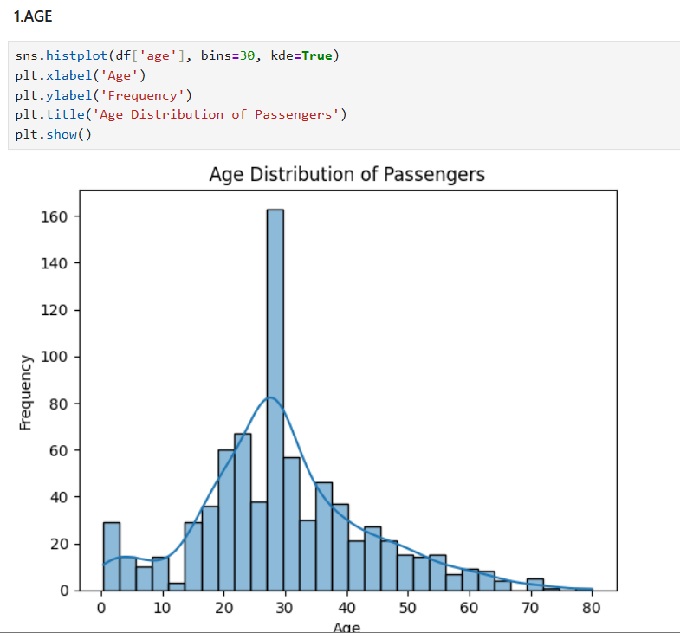
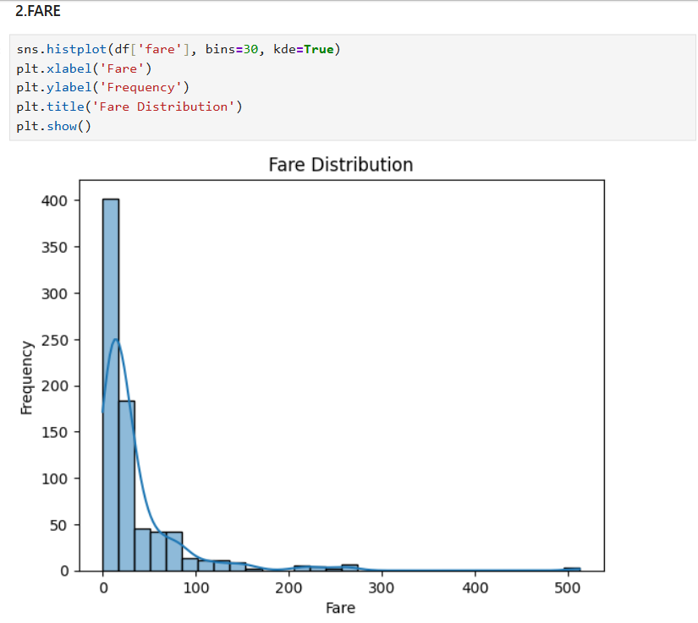
7.Data Analysis through Visualizations
Univariate analysis(Numerical)
U

Slide 18
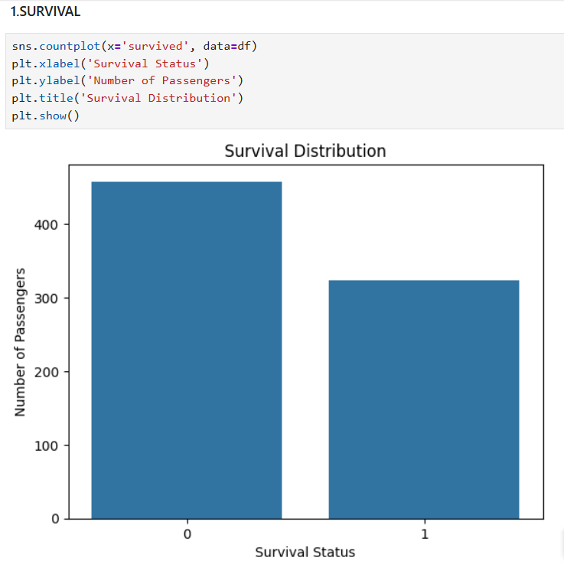
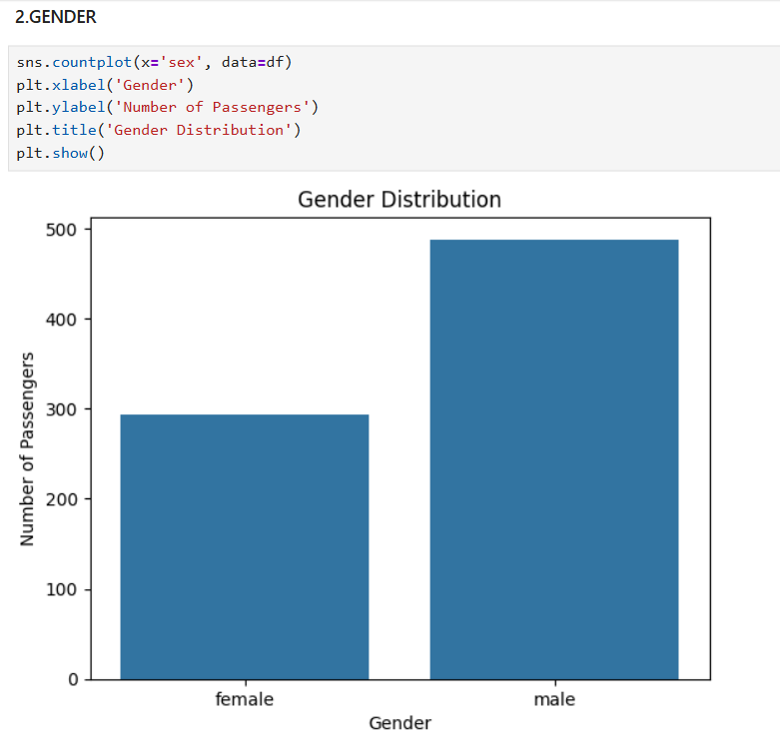
CATEGORICAL

Slide 19
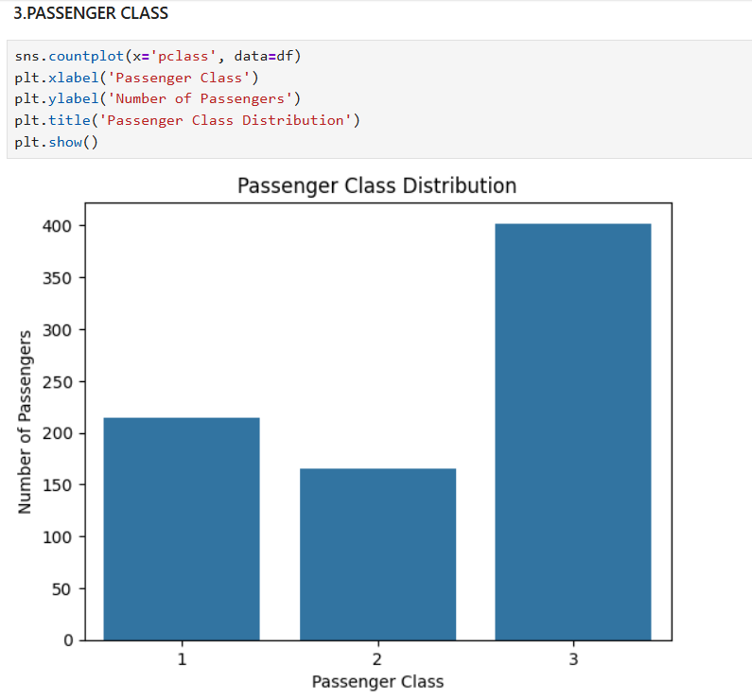
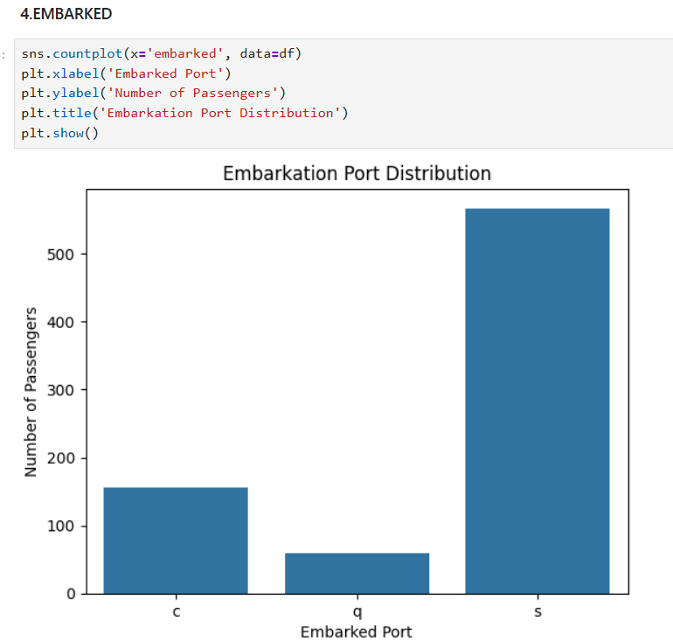

Slide 20
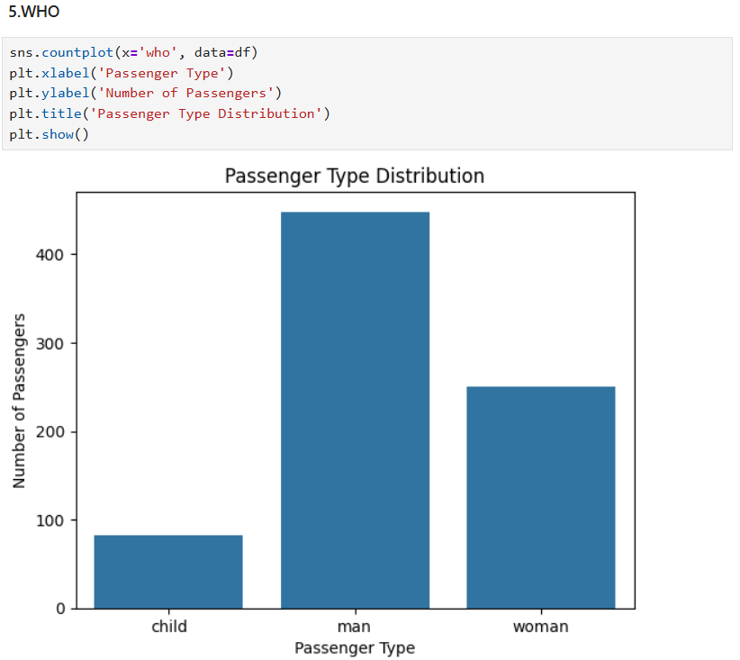

Slide 21
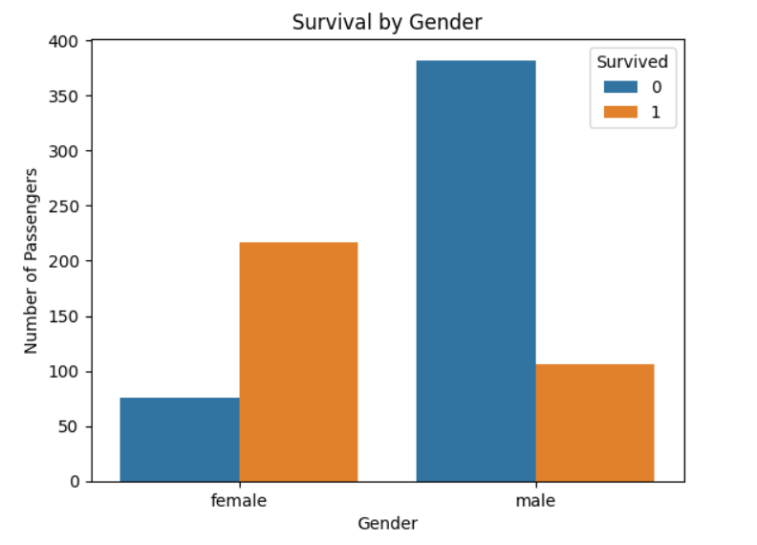
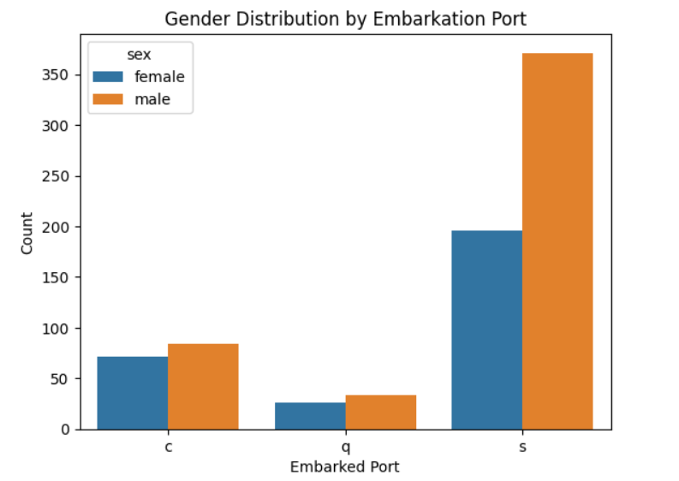
8.Bivariate analysis – categorical to categorical
1. Survival vs Gender
2. Gender vs Embarked

Slide 22
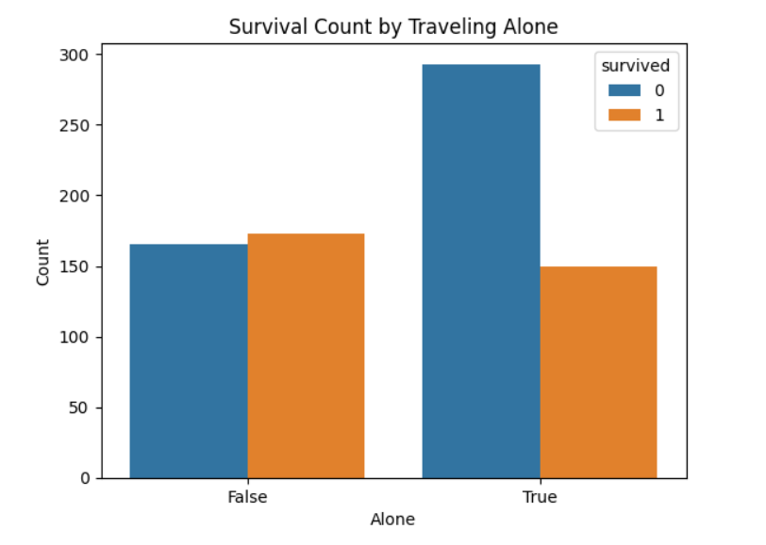
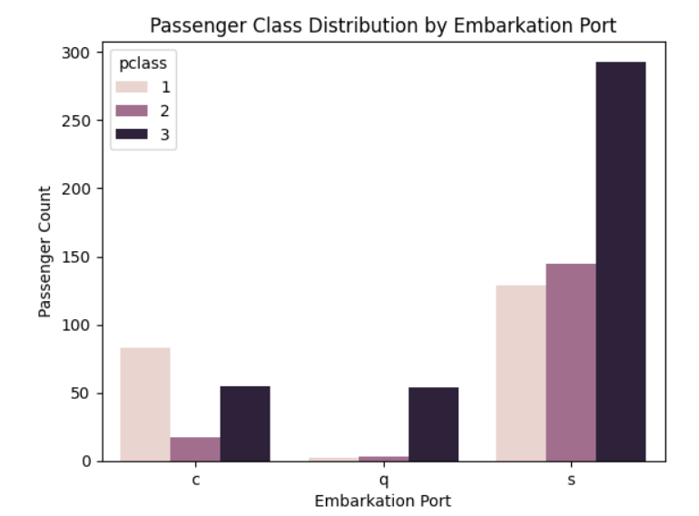
3. Survival vs Alone
4. Embarked vs passenger class

Slide 23
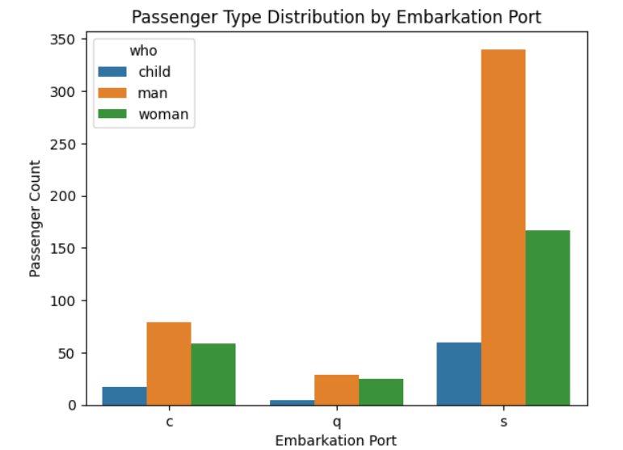
5. Who vs Embarkation

Slide 24
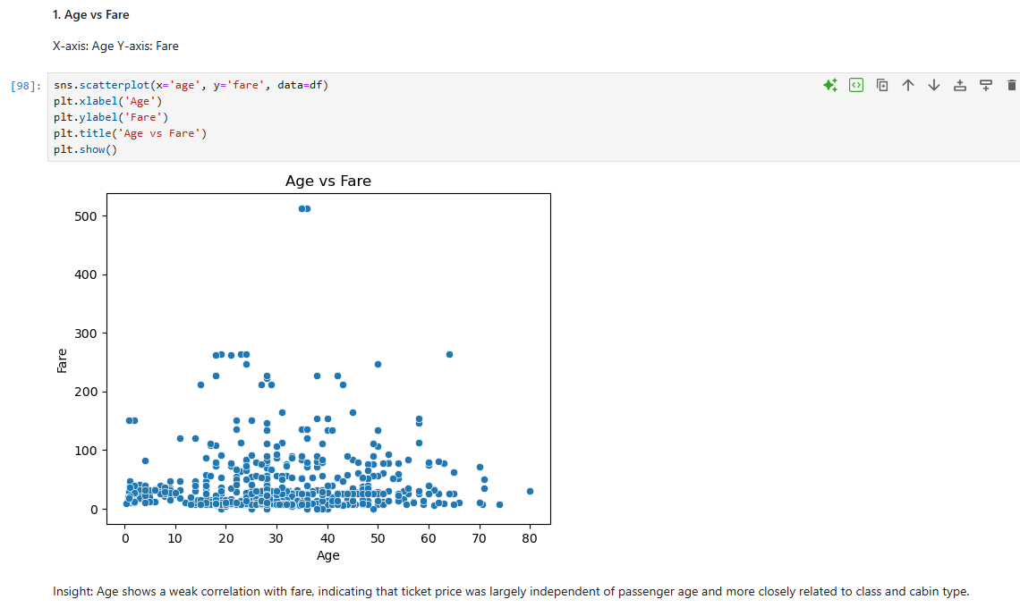
Visual Bivariate Analysis - Numerical to Numerical

Slide 25
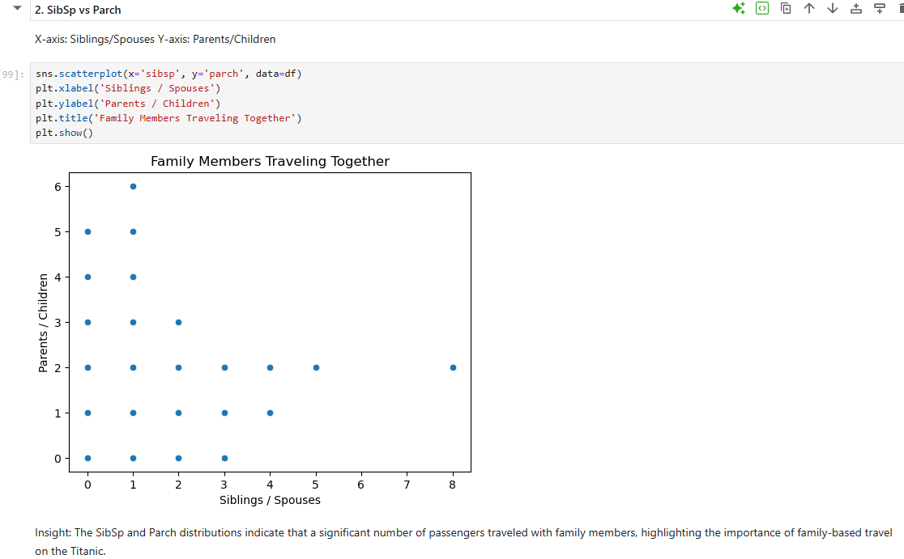

Slide 26
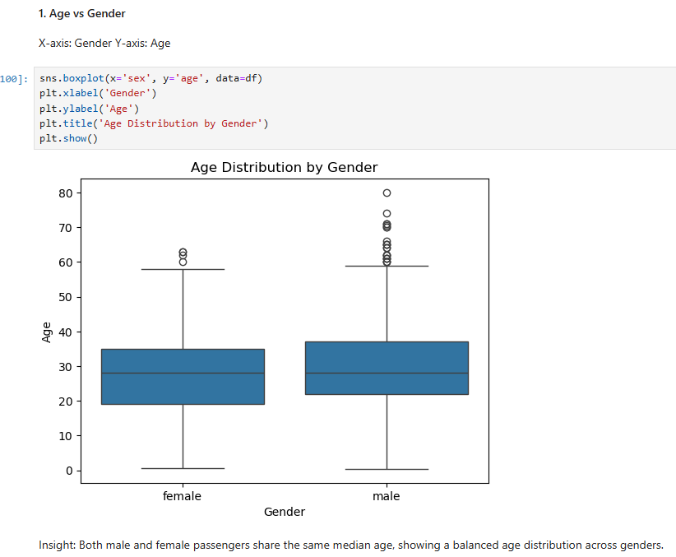
Numerical - Categorical OR Categorical- Numerical

Slide 27
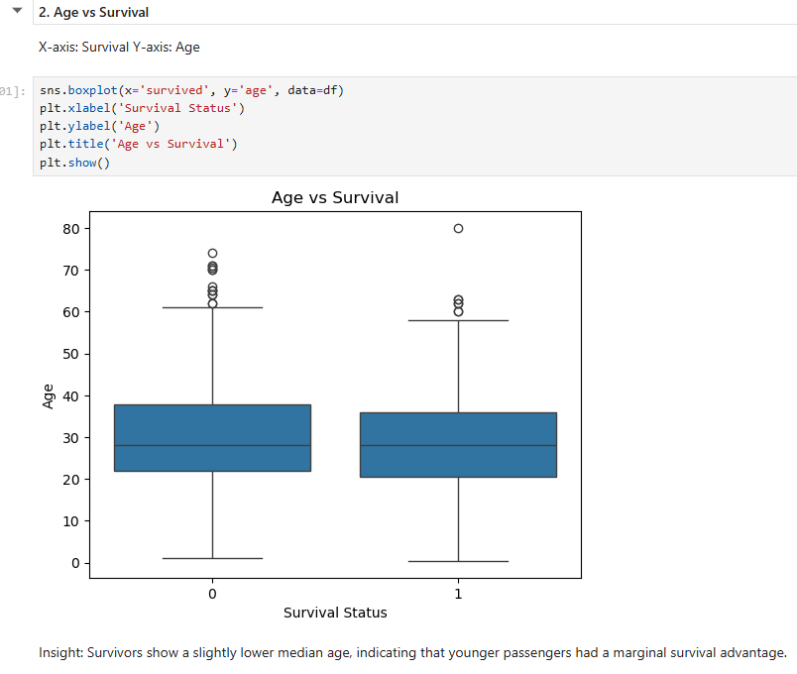

Slide 28
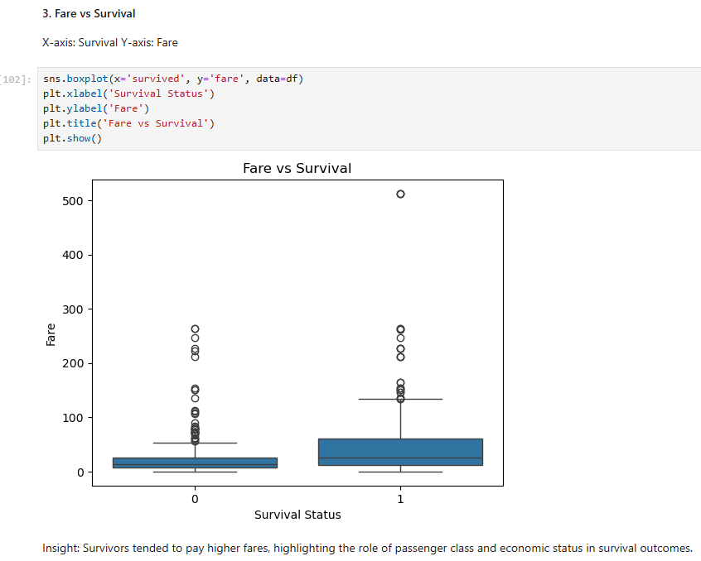

Slide 29
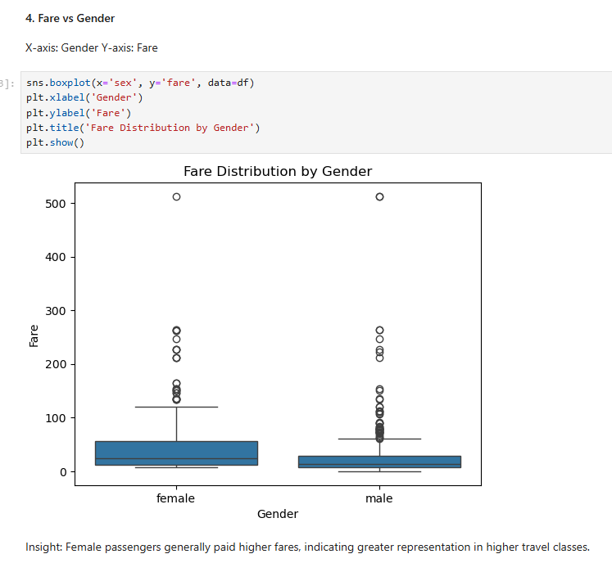

Slide 30


9.Multivariate Visualisation

Slide 31


Slide 32


Slide 33


Slide 34
PHASE-2 SUMMARY:
The initial Titanic dataset contained several data quality issues that required attention before analysis. Missing values were observed in key columns such as age, embarked, deck, and embark_town, with the deck column having a large proportion of missing entries. Additionally, duplicate records were identified and removed to prevent skewed results.
Missing values were handled using appropriate strategies based on data type and significance. Numerical missing values in age were imputed using the median to avoid the impact of outliers. Categorical missing values in embarked and embark_town were filled using the mode, while missing values in deck were replaced with the most frequent category to preserve structural information. Duplicate rows were removed, and categorical inconsistencies such as extra spaces and formatting issues were resolved. Repeated text columns were also converted to categorical data types to improve efficiency and clarity.
Non-visual bivariate analysis revealed meaningful relationships between variables. Survival was strongly influenced by gender, passenger class, and fare, with females and first-class passengers showing higher survival rates. Fare was positively associated with survival, while age alone showed limited influence. Family-related variables such as sibsp and parch displayed a positive relationship, indicating that passengers often traveled in family groups.
Visualization analysis revealed clear patterns in passenger demographics and survival outcomes. Univariate plots showed most passengers were aged 20–40, while fare distribution was highly right-skewed. Bivariate analysis indicated that females and higher-fare passengers had better survival rates. Survivors were generally slightly younger than non-survivors. Multivariate visualizations highlighted how passenger class, embarkation port, and passenger type jointly influenced survival and travel patterns. Overall, visual analysis provided meaningful insights into factors affecting passenger outcomes.

Slide 35
Thank you

